Slide 1
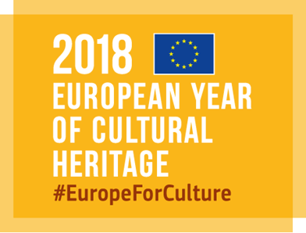
Getting to Know EUROPE HeritaGEO
Getting to know Europe Cultural Heritage with geo-localization Maps

Slide 2
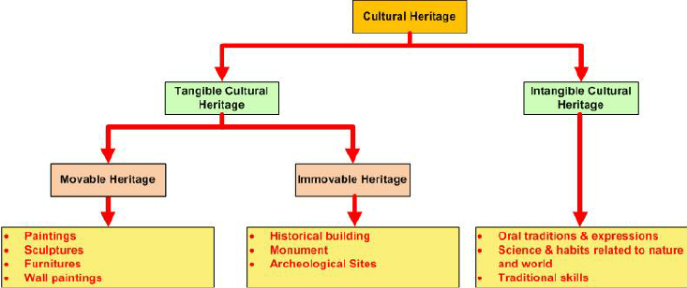
CULTURAL HERITAGE COMES IN MANY SHAPES AND FORMS
digital
natural
landscapesflora and fauna

Slide 3
CULTURAL HERITAGE: SOME EXAMPLES
> Buildings, monuments, artefacts, archives, clothing, artworks, books, machines, historic towns, archaeological sites, etc. – tangible heritage
> Practices, representations, expressions, knowledge, skills, objects and cultural spaces that people value, such as festivals, in addition to language and oral traditions, performing arts, and traditional crafts, etc. –intangible heritage
> Landscapes and geographical areas where nature shows evidence of cultural practices and traditions, such as gardens –nature heritage
> Resources created in a digital form (for example digital art and animation) or that have been digitalised as a way of ensuring their preservation (including text, images, videos, and records) –digital heritage

Slide 4
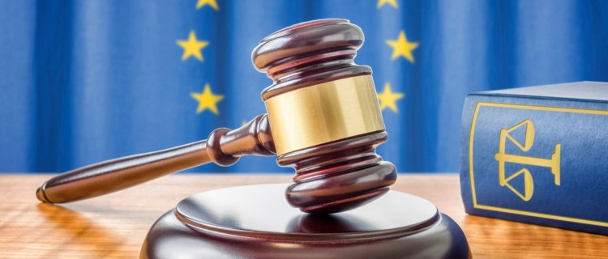
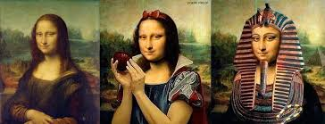
WHAT A MESS IS IT?
EU LAWS
ARTS

Slide 5
BRINGING ALL IT TOGETHER

Slide 6
LET’S START WORKING ON…
Used as useful application software for presenting all heritage information collected on the assets we want

Slide 7
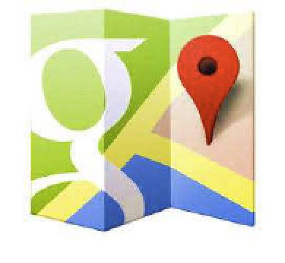
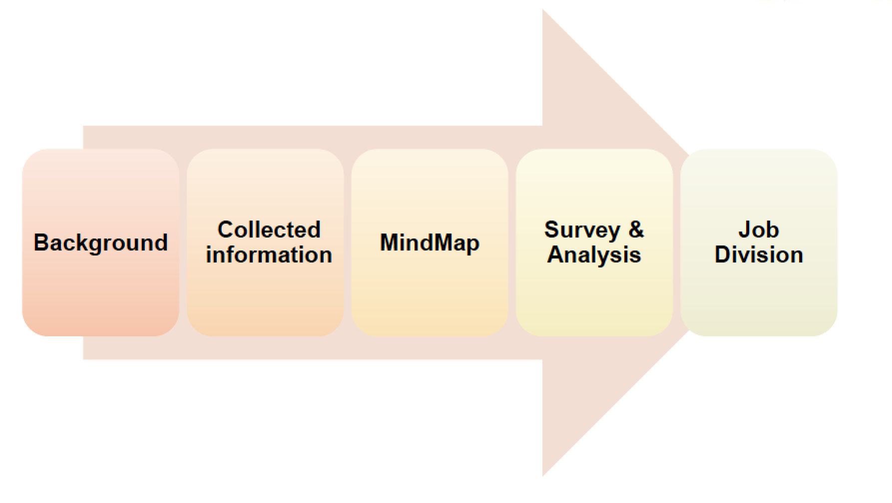
HOW SHOULD WE WORK?

Slide 8
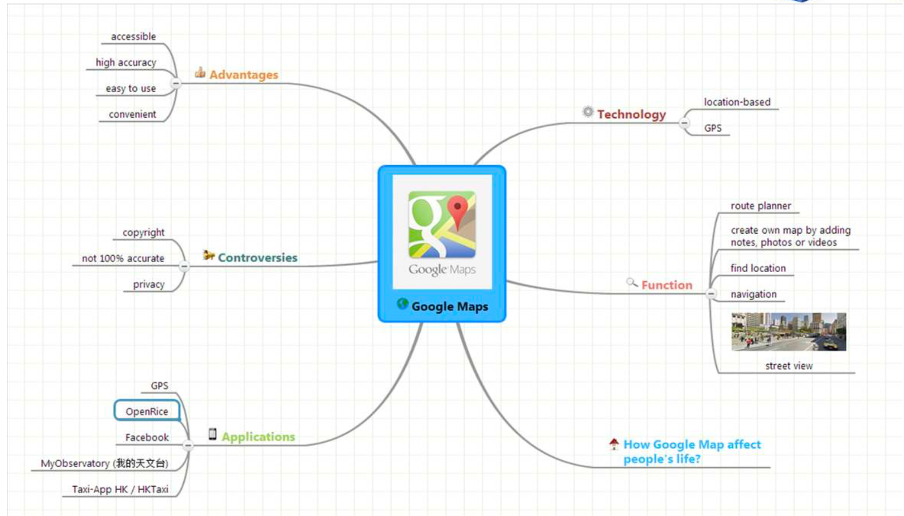
MIND MAP

Slide 9
FINAL CONSIDERATIONS
People nowadays are familiar with technology. With the development of smart phones, Google Maps, which is an essential and portable tool on directing, is getting more important and commonly-used.
It is also embedded in many websites and applications that people are able to use it for different purposes, e.g. finding restaurants nearby and making taxi calls.
It is likely that Google Maps will have a larger coverage of users in the near future as mapping technology is getting accessible to everyone with the aid of Internet.
Google Maps is one of the innovations in the decade that brings great improvements to our lives.

Slide 10
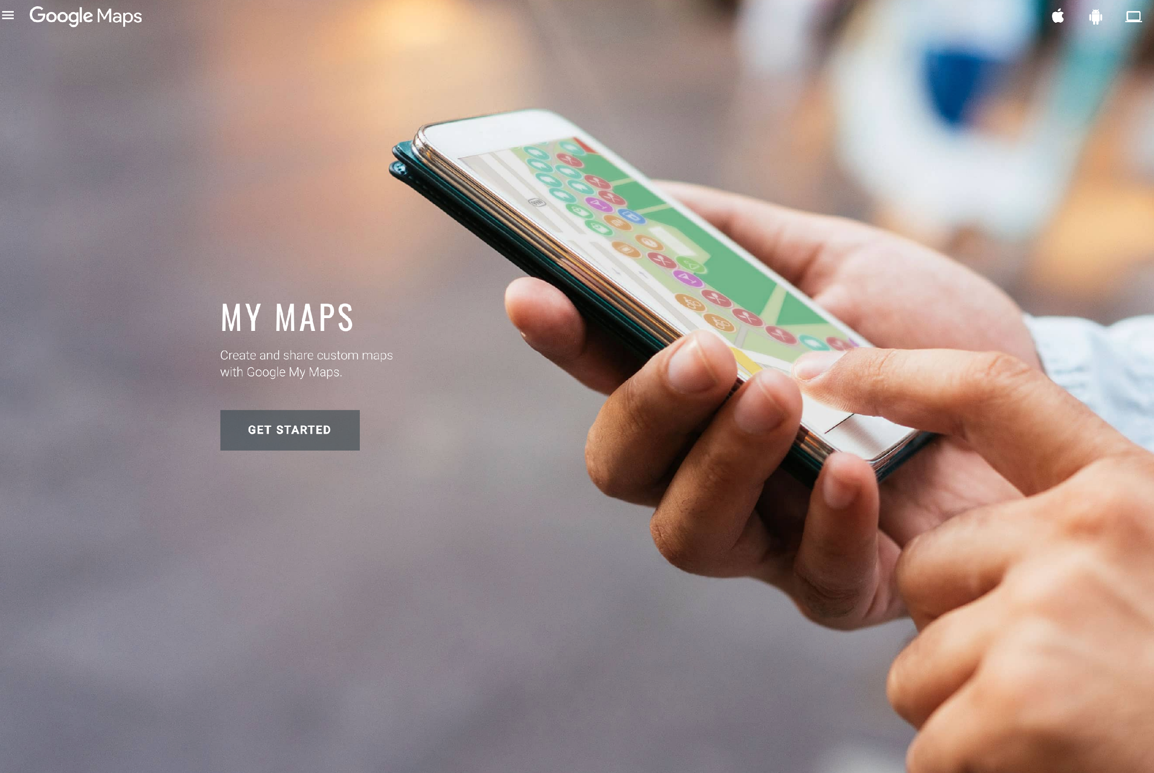
GET STARTED

Slide 11
LET’S CREATE THE WORKING GROUPS
for the final Project works
Carnival festivals in EU G1: catania, d’occhio, conte, puntuorno, capasso
Natural parks of EU G2: borzacchiello, cimmino, de magistris, piscopo, sarker
Travelling EU by car G3: briante, cavassi, pecovela, puca,
Unesco Edible geography G4: musella, capasso andrea, amato, del prete, cammisa, donetto, chiantese
Main EU Worship Places G5: soffici, capuano, gervasio, Damiano
Presentation Group G6: copellino, iorio,
Group A
Group B
Group C

Slide 12
The G1’s PROJECT WORK: Carnival festivals in EU
Catania, D’occhio, Conte, Puntuorno, Capasso Ar.
APRI A TUTTO
SCHERMO

Slide 13
The G2’s PROJECT WORK: Natural parks of EU
Borzacchiello, Cimmino, De Magistris, Piscopo, Sarker
APRI A TUTTO
SCHERMO

Slide 14
The G3’s PROJECT WORK: Travelling EU by car
Briante, Cavassi, Pecovela, Puca
APRI A TUTTO
SCHERMO

Slide 15
The G4’s PROJECT WORK: Unesco Edible geography
Musella, Capasso Andrea, Amato, Del Prete, Cammisa, Donetto, Chiantese
APRI A TUTTO
SCHERMO

Slide 16
The G5’s PROJECT WORK: Main EU Worship Places
Soffici, Capuano, Gervasio, Damiano
APRI A TUTTO
SCHERMO

Slide 17
WHERE DO WE START FROM?
Linkography:
https://europa.eu/cultural-heritage/about_en (EU cultural heritage)
https://visitworldheritage.com/en/eu/ UNESCO
https://www.europeanheritagedays.com/Heritage-Initiatives/
Wikipedia
https://ec.europa.eu/programmes/creative-europe/actions/heritage-label_en European Heritage Label (EU)
https://www.coe.int/en/web/cultural-routes/home European Cultural Routes
http://www.youdiscover.eu/ Travel Europ on Interrail
file sharing (check your email)
Online Game | Kahoot
https://europa.eu/cultural-heritage/toolkits_en?page=1 (PPT)

